Slide 1
Wasserstein GAN for cell images
Zheng Lu

Slide 2
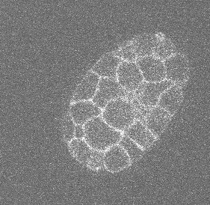
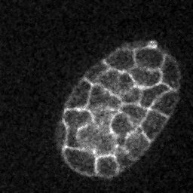
Input image preprocess using ImageJ
Each image stack has 30 slices. I only use the 10th-20th, as they look similar in shape and size.
We have 76 stacks, resulting in 760 training images.

Slide 3
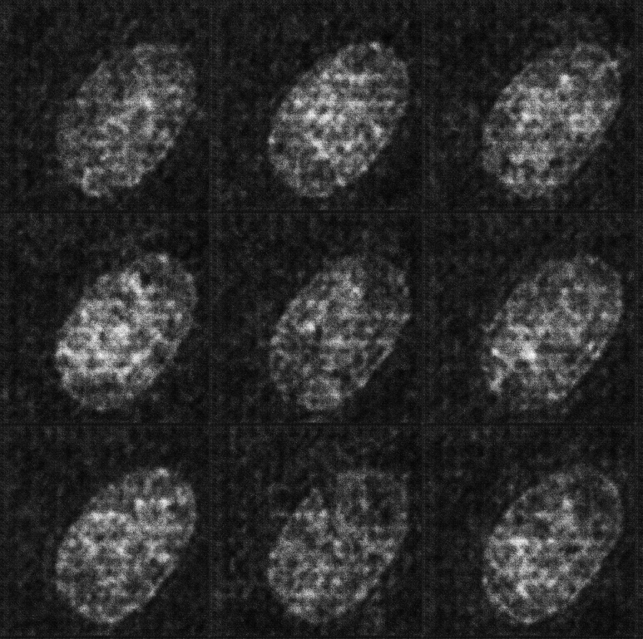
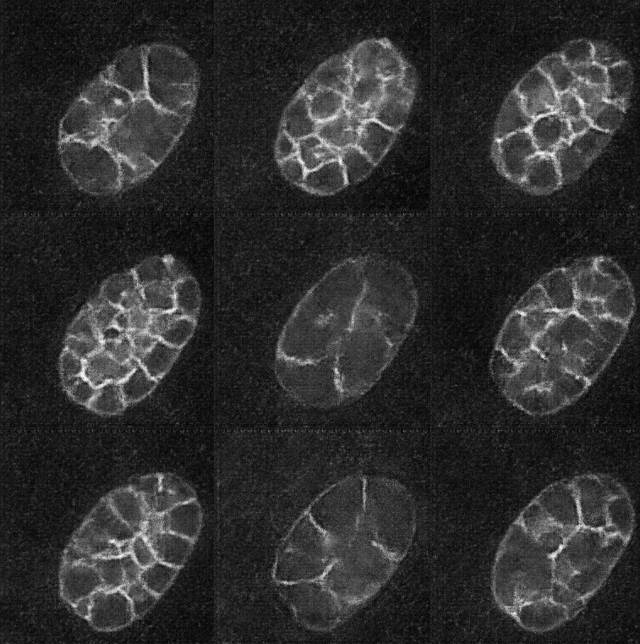
Train the DCGAN for 1000 epochs.
Epoch 8:
Blur, only the outline,
no clear structure
Epoch 80:
Noisy, structures are still blurry

Slide 4
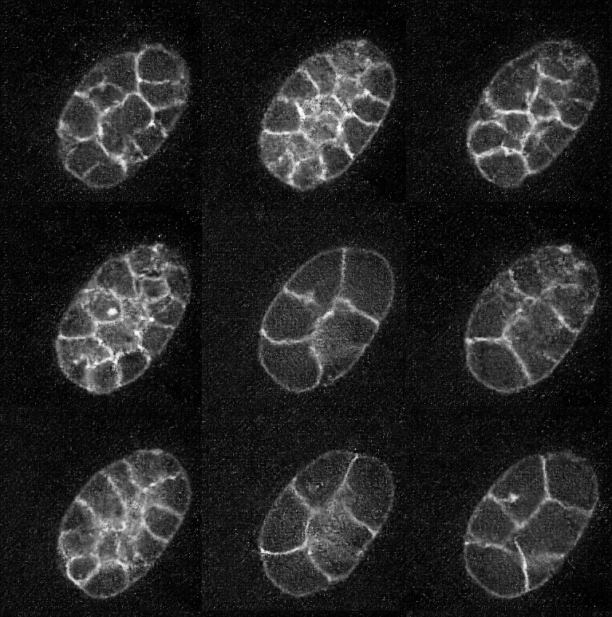
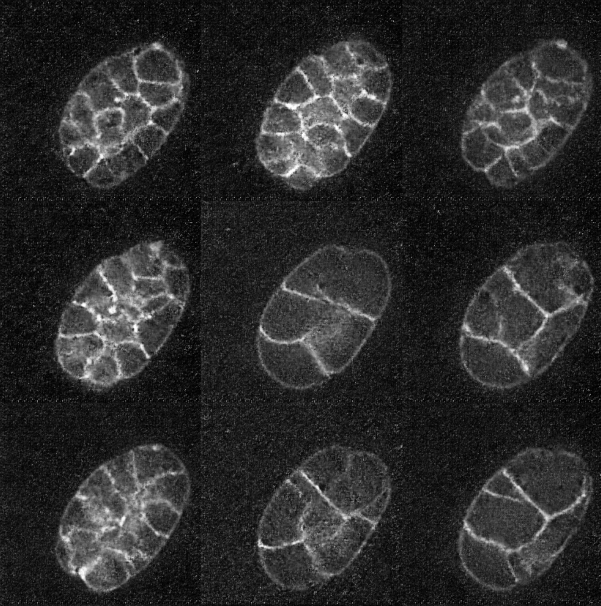
Train the DCGAN for 1000 epochs.
Epoch 500:
Lightly noisy, structures are clearer
Epoch 1000:
Still lightly noisy, not much improve. Actually, noise becomes more clear

Slide 5
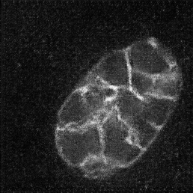
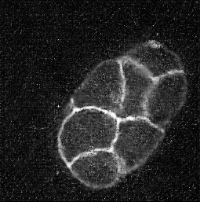
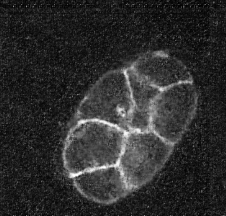
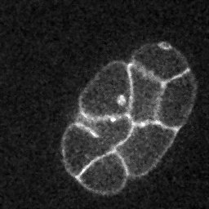
Single cell view
100 epoch
500 epoch
1000 epoch
Ground truth
It seems 1000 epoch results are more noisy than 500 epoch results. But they catch more inside structure details of the cell (e.g., small dots inside cells).

Slide 6
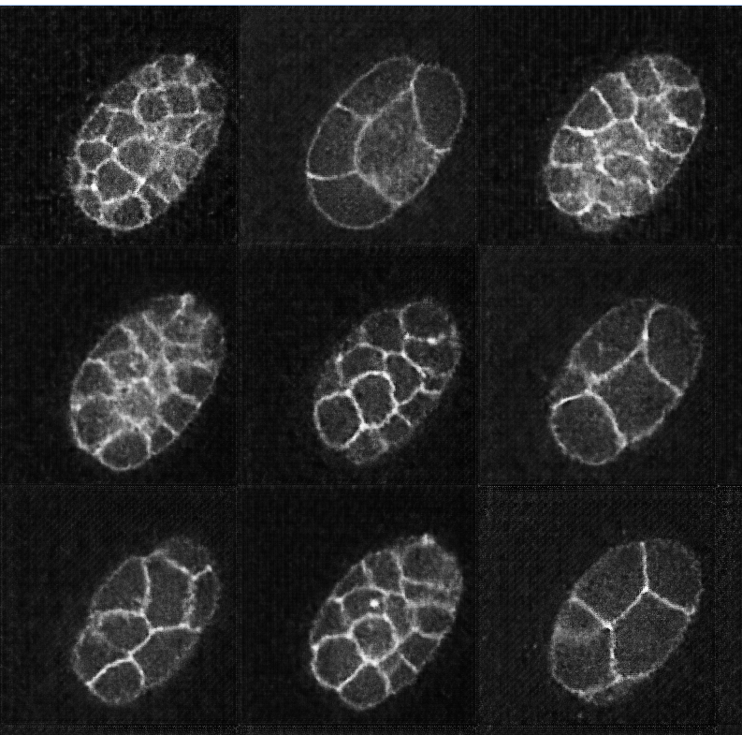
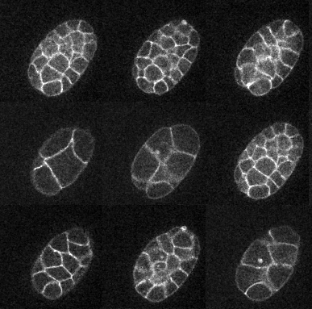
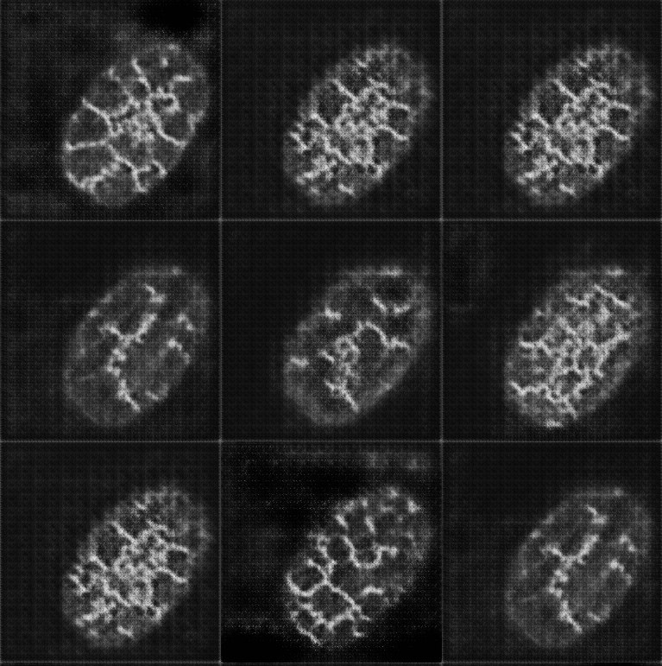
A more complex network for both unconditional gan and conditional gan
Unconditional
Real
Conditional

Slide 7
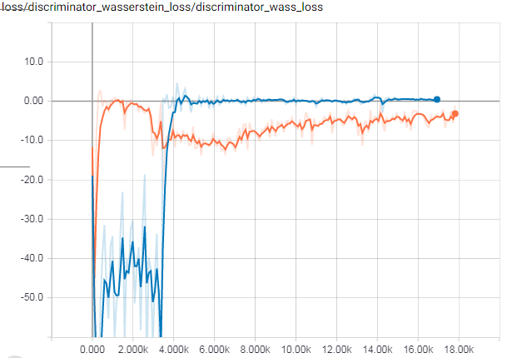
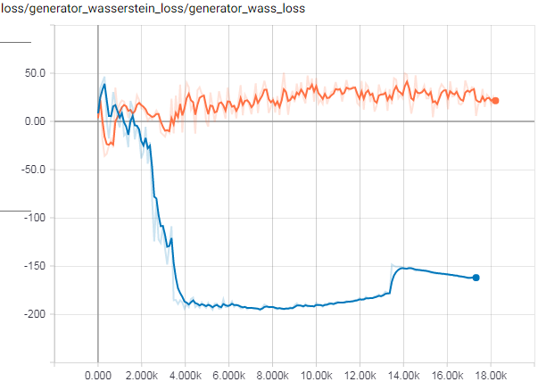

Loss function for unconditional gan and conditional gan
Loss for D
Loss for G

